Slide 1


Sentimental Analysis
Student`s Name:
Isaac Chinagorom Esonotu - A00162779
Cristobal Gonzalez - A00083919
Course: ISY503 Intelligent Systems
Notes:
Good morning/afternoon], everyone. Welcome to my presentation on Amazon Sentiment Analysis .In this project, we explore how to apply Natural Language Processing techniques combined with deep learning, specifically LSTM networks, to classify product reviews from Amazon as either positive or negative.
Throughout this presentation, I’ll walk you through the problem, the data, the preprocessing pipeline, the model building process, and finally the results and insights we gained.
Let’s begin with the problem statement and understand why this analysis is important.

Slide 2

Introduction
Develop an automated sentiment analysis system that Accurately classifies Amazon product reviews as positive or negative and the model Is generalizable across multiple product categories
Key Challenges
Data Cleaning: Reviews contains noise like HTML tags, URLs, and typos
Imbalanced Data: Varying distribution of positive and negative reviews
Model Robustness: Handling slang, sarcasm, or uncommon words
Deployment: Building a user-friendly interface for real-world use
Notes:
The core problem we are addressing in this project is automated sentiment classification of Amazon product reviews. With millions of reviews being posted online, it's nearly impossible to manually go through all of them. The reviews contains valuable information which is very useful for decision making for both the business and the customers.
Our goal is to build a model that can automatically identify whether a given review expresses a positive or negative sentiment
This kind of sentiment analysis can be used in:
- Recommender systems
- Customer feedback analysis
- Market trend prediction
- Brand reputation management
To tackle this, we leverage Natural Language Processing (NLP) and deep learning—specifically Long Short-Term Memory (LSTM) networks, which are well-suited for understanding the sequential nature of text data.

Slide 3

Ethical Considerations
Data Privacy and Confidentiality
Ensuring no personally identifiable information (PII) is included in the dataset.
Data cleaning process involved anonymizing sensitive details like user emails, names, or profile information.
Bias and Fairness
Addressing inherent biases in the data by ensuring diverse representation across different product categories and demographics.
Striving for fairness in model predictions to avoid favoring any particular group.
Transparency and Accountability
Emphasizing model interpretability and using techniques like SHAP or LIME to understand how predictions are made.
Notes:
Before diving into the technical aspects of the project, it's important to recognize the ethical considerations that guided our approach throughout the development process. As we worked with data and machine learning models, we made sure to prioritize privacy, fairness, and transparency.
Data Privacy and Confidentially: We ensured no personally identifiable information (PII) was included by anonymizing sensitive data during the cleaning process.
Bias and Fairness: We made sure the data represented diverse groups and avoided bias, ensuring fair predictions for all demographics.
Transparency and Accountability: We focused on model transparency, using tools like SHAP and LIME to explain how predictions were made, ensuring accountability.

Slide 4






DATA
Amazon Multi-Domain Sentiment Dataset
Features
Id - Unique value for each review
ProductId - Unique number for product for which they reviewed
UserId - Unique number for user
ProfileName - Name of the user who gave review
HelpfulnessNumerator - No of users who gave that review as helpful
HelpfulnessDenominator - Total of users who found review is helpful/not
Score - Rating complied by a user for a review
Time - This feature is useful in Data Cleaning
Summary - Overview text for their review (like heading)
Text - Review by the user to the product
Product Categories
DVDs
Electronics
Books
Kitchens & housewares
Reviews segmentation
positive.review` — user reviews with positive sentiment
negative.review` — user reviews with negative sentiment
Source:
Johns Hopkins University NLP Group
Link:
http://www.cs.jhu.edu/~mdredze/datasets/sentiment/index2.html
Notes:
The Amazon Multi-Domain Sentiment Dataset is sourced Biographies, Bollywood, Boom-boxes and Blenders: Domain Adaptation for Sentiment Classification a paper done by John Hopkin university NLP Group. It's a well-known benchmark dataset for sentiment analysis tasks and is freely available for academic use.
It provides balanced and labeled data across multiple product categories, which makes it ideal for training and evaluating sentiment classification models.
The dataset has various folders each contains a specific item review. For each folder it has items the reviews are sorted into negatives and positives reviews files. The items for:
- Books
- DVDs
- Electronics
- Kitchen & Housewares
The reviews has the following features.
Id - Unique value for each review
. ProductId - Unique number for product for which they reviewed
UserId - Unique number for user
ProfileName - Name of the user who gave review HelpfulnessNumerator - No of users who gave that review as helpful
HelpfulnessDenominator - Total of users who found review is helpful/not
Score - Rating complied by a user for a review
Time - This feature is useful in Data Cleaning
Summary - Overview text for their review (like heading)
Text - Review by the user to the product

Slide 5

Libraries Used
Natural Language Processing (NLP)
nltk: Used for essential NLP tasks like tokenization, stopword removal, and stemming.
re: Employed for cleaning raw text using regular expressions to remove unwanted patterns
Machine Learning & Deep Learning
Tensor/Keras: Utilized for building and training the neural network (specifically LSTM models)
Gensim: Used to load and work with pre-trained word embeddings like Word2Vec and GloVe.
Dataa Handling & Utilities
NumPy: Used for numerical operations and efficient array processing.
Scikit-learn: Supports data splitting and shuffling for proper training and evaluation.
Pickle: Helps in saving and reloading preprocessed datasets to reduce processing time..
Visualization
Matplotlib: Used to visualize training performance through plots
Notes:
To build this sentiment analysis system, we utilized several key Python libraries:
NumPy was used for numerical computations and array handling, which is essential for managing datasets and model outputs.
Matplotlib helped us visualize data distributions and insights, especially during preprocessing and evaluation.
NLTK provided tools for natural language processing tasks like tokenization, stopword removal, and text cleaning.
TensorFlow was used to design, train, and evaluate our LSTM-based deep learning model.
Scikit-learn assisted with data splitting, shuffling, and basic utilities to streamline our ML pipeline.
Gensim was crucial for loading and integrating pre-trained word embeddings like GloVe.
Finally, Pickle allowed us to save and reload preprocessed data efficiently, which is important due to the size of the dataset and preprocessing time
Let’s now move to data cleaning and visualization

Slide 6

Data, Cleaning, Visualization
Removing the rows with same User Id, profile name, time and text also. Duplicate reviews are deleted
Helpfulness numerator < = de nominator
Removing unnecessary Columns
1.Id
2. Timestamp 3. ProfileName
4. HelpfulnessDenomnitor
Converting categorical product ID into numerical
Notes:
In this stage, we focused on preparing the raw dataset for effective modeling.
The first thing do was to remove the duplicated rows that had the same UserId, `ProfileName, Time, and Text. This helped eliminate repeated reviews which could bias the model.
Next was filtering out entries where the helpfulness numerator was greater than the denominator, which indicates unreliable feedback data.
The ProductID, originally in a categorical format, was converted into a numerical format to ensure compatibility with our machine learning algorithms.
Additionally, we removed irrelevant columns such as:
Id: a simple index that doesn't carry meaningful information.
Timestamp: which wasn't useful for sentiment analysis.
ProfileName: potentially introduces noise without adding predictive value.
HelpfulnessDenominator: redundant after we applied our filtering rul

Slide 7
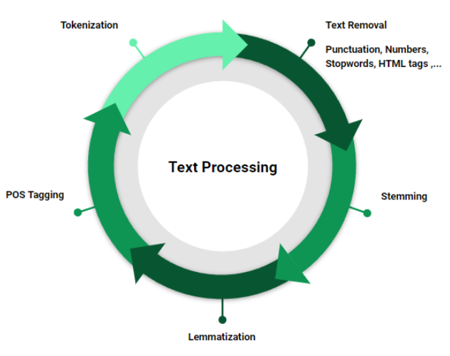
Text preprocessing
Removing Html tags
Case normalization where all text was converted to lowercase
Removal of URLS emails and special characters to reduce noise from the text
Punctuation removal
Tokenization- splitting sentences into individual words
Stop ward removal – Removes common English stop words
Notes:
The text underwent a vigorus text preprocessing process to ensure that the data was fit for the learning phase of the model. We are going to go over the various techiques used to convert the raw data into training and testing format required for NLP models.
Tag Removal: We started by removing HTML-like tags such as `<review_text>` that were used to wrap reviews. These are not useful for sentiment analysis.
Lowercasing: We converted all text to lowercase to ensure consistency and avoid treating words like "Great" and "great" as different tokens.
Removing URLs and Emails: These elements don’t contribute to sentiment and were removed to reduce noise.
Handling Special Characters: Characters like '@' were often used to obscure offensive words. We replaced them with 'a' to normalize them.
Punctuation Removal: All punctuation was stripped out, as they generally don’t affect sentiment classification.
Tokenization: We broke down each review into individual words using `word_tokenize`, making it easier to process.
Stopword Removal: Common words like "the", "is", and "and" that do not carry sentiment were removed using NLTK's stopword list.

Slide 8

Data Encoding
1. Vocabulary Creation
Builds a set of unique words from the training data.
Each word is assigned a unique integer ID.
2. Word-to-ID Mapping
word2id`: Maps words to numeric IDs.
id2word`: Maps IDs back to words for decoding.
3. Sentence Encoding
Converts each sentence (list of words) into a list of corresponding word IDs.
4. Sequence Padding
Pads or truncates all sequences to a fixed length (e.g., 1 using `pad_sequences`.
Ensures uniform input size for the model.
Notes:
Once the text data is preprocessed and cleaned, the next major step was data encoding, the textual information was converted into a numerical format that machine learning models can work with. Now let dicuss the various data encoding tecnniques employed on the data.
Vocabulary Creation: First, we created a vocabulary from the training dataset. This is a set of all unique words found across all the cleaned reviews.
Word to ID Mapping: Each unique word in the vocabulary was assigned a unique integer ID. This forms a `word2id` dictionary for encoding and an `id2word` dictionary for decoding if needed.
Sentence Encoding: We then converted each tokenized sentence into a sequence of integers using the `word2id` dictionary. If a word was not found in the vocabulary, we assigned it a dummy ID — this helps handle unseen or rare words gracefully.
Padding: Since reviews have different lengths, we padded all sequences to a fixed length of 125 tokens. This uniformity is crucial because deep learning models expect inputs of the same shape. Padding was done post-sequence to avoid distorting the meaningful beginning of each review.
By completing this step, we transformed human-readable text into structured numeric data that could be directly fed into our LSTM-based deep learning model.

Slide 9
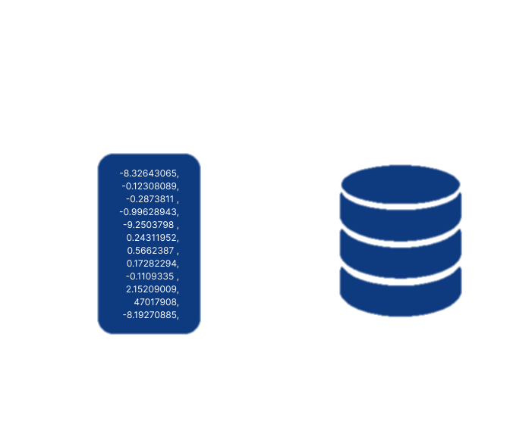
Embedding
Embedding Matrix
Constructed using the pretrained Glove vectors
Maps each word ID to its corresponding vector
Used to initialize the embedding layer in the LSTM Model
Pre-trained Model:glove-twitter-200
Trained on 2B tweets
200-dimensional vectors
1.2M word vocabulary
Notes:
Now that our data is numerically encoded, the next step is to enhance its semantic understanding using word embeddings.
The project utilized pre-trained embeddings from the GloVe Twitter 200 model. This model was trained on 2 billion tweets and captures rich contextual relationships between words in 200-dimensional vectors.
Here's how embeddings added value:
Semantic Representation: Unlike one-hot encoding or raw integer values, word embeddings capture the *meaning* and *relationship* of words. For example, "great" and "excellent" will have similar vectors because they are semantically close.
Pre-trained Advantage: Using pre-trained embeddings saved us training time and gave our model access to a broader understanding of language — even beyond the specific Amazon dataset.
Embedding Matrix: We created an embedding matrix that maps each word ID in our vocabulary to its corresponding GloVe vector. Words not found in GloVe were initialized with zero vectors.

Slide 10
Model Building
Layers used
Compilation Settings
Training Setup
Embedding layer
LSTM Layers
Dense layers
Compilation Settings
Optimizer (Adam)
Loss function (Binary Crossentorpy)
Metrics (accuarcy)
Batch Size: 50
Epochs: 50
Validation Split: 20% of training data
Notes:
For this project, we built a Long Short-Term Memory (LSTM) model to predict sentiment (positive or negative) from Amazon product reviews. LSTM is a type of Recurrent Neural Network (RNN), which is ideal for sequential data, such as text.
Here’s a breakdown of the model-building process
Input Layer: We begin by feeding sequences of encoded words into the model. The input shape corresponds to the maximum sequence length (125 words in this case), and each word is represented by its integer ID from our vocabulary.
Embedding Layer: This is where the magic of word embeddings comes in. The embedding layer transforms these integer IDs into dense word vectors (we used the pre-trained GloVe vectors). This allows the model to work with semantically rich representations of words instead of their raw, meaningless IDs.
LSTM Layers: We used two LSTM layers, each with 30 units. These layers are responsible for learning the sequential patterns in the reviews and understanding the context across the sequence of words. LSTMs are excellent for handling long-range dependencies in text, making them ideal for this task.
Dense Layer: The final dense layer has a single neuron with a sigmoid activation function. This outputs a probability value between 0 and 1, which represents the sentiment of the review. If the value is closer to 1, the sentiment is positive; if it's closer to 0, the sentiment is negative.
Compilation: For optimization, we used the Adam optimizer, which adapts the learning rate and is highly effective for training deep learning models. The loss function is binary crossentropy, as we are dealing with a binary classification problem (positive vs. negative).

Slide 11
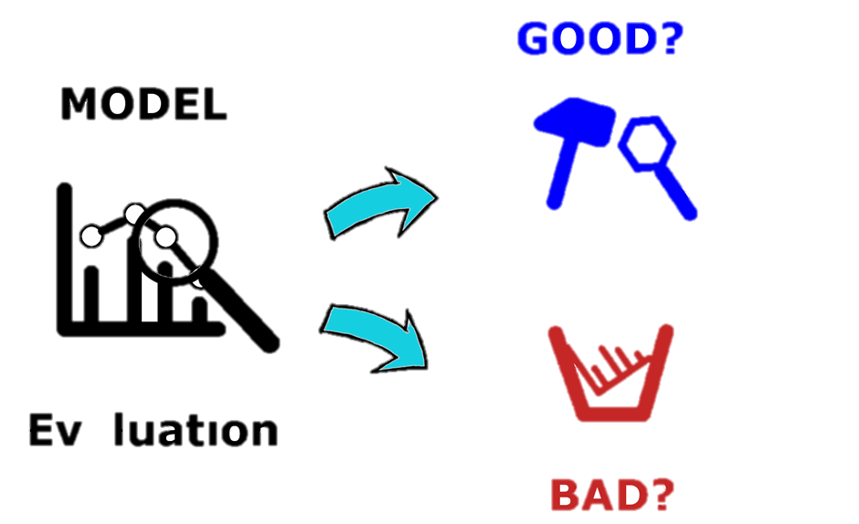
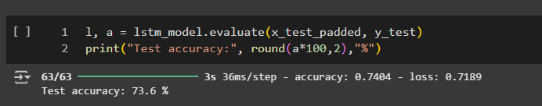
Model Evaluation
Accuracy
Measures the percentage of correctly classified reviews
The test accuracy result showed the model had an accuracy of 73 .6%
The results demonstrated the model’s ability will have high chances of correct categorizing sentiments into either positive or negative sentiments
Notes:
After training our LSTM model on the Amazon review data, we evaluated its performance on a separate test dataset to assess how well it generalizes to unseen reviews.
The model achieved a test accuracy of approximately 73.6%, with a **loss of 0.7189**. This means that out of all the reviews in the test set, the model correctly predicted the sentiment about 74% of the time.

Slide 12
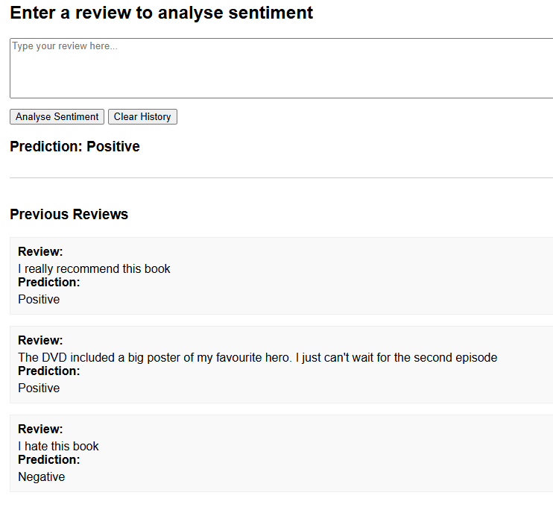

Custom Predictions
Notes:
To further validate our model beyond accuracy metrics, we used a few custom examples to see how well it predicts sentiment in real-world sentences.
The sentence _"I really recommend this book"_ was classified correctly as **Positive**.
- This is expected, as the sentiment is very clear and strongly worded in a positive direction.
The input _"The DVD included a big poster of my favorite hero. I just can't wait for the second episode"_ was also classified as Positive.
This is a good sign that the model understands sentiment beyond basic keywords. The excitement and enthusiasm in the phrasing helped the model predict accurately.
The sentence _"I don't know what the hell did I just read, the book is full nonsense"_ was rightly identified as Negative.
This shows that the model can capture harsh or critical language effectively.

Slide 13
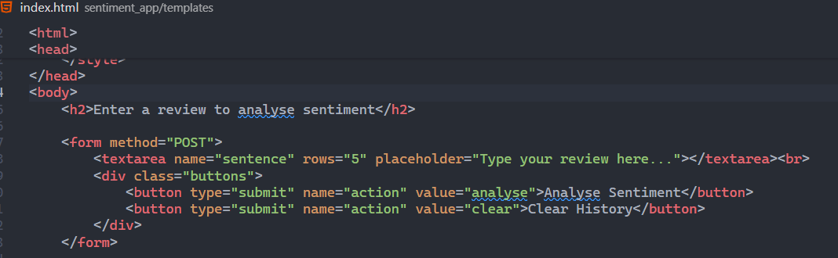
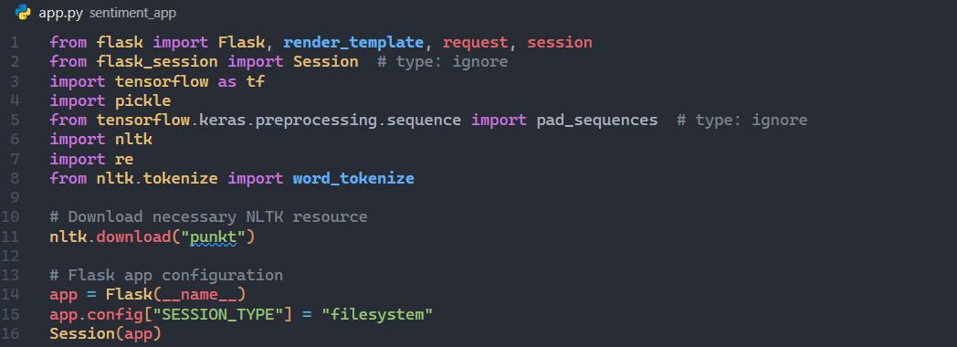
User Interface
The user interface was created with Flask
The User Interface is clean and easy to use
Notes:
After training our LSTM model on the Amazon review data, we evaluated its performance on a separate test dataset to assess how well it generalizes to unseen reviews.
The model achieved a test accuracy of approximately 73.6%, with a **loss of 0.7189**. This means that out of all the reviews in the test set, the model correctly predicted the sentiment about 74% of the time.

Slide 14
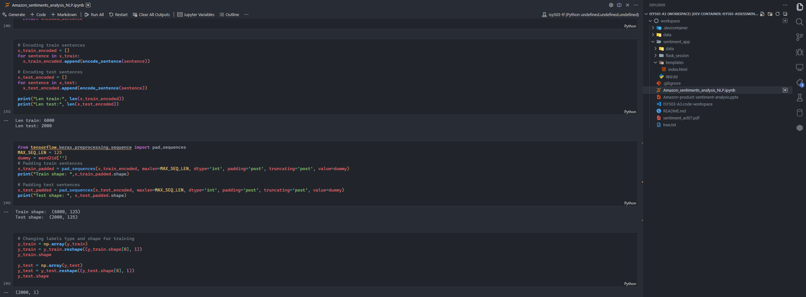
Project Environment
The project was deployed under the devcontainer methodology.
Notes:
After training our LSTM model on the Amazon review data, we evaluated its performance on a separate test dataset to assess how well it generalizes to unseen reviews.
The model achieved a test accuracy of approximately 73.6%, with a **loss of 0.7189**. This means that out of all the reviews in the test set, the model correctly predicted the sentiment about 74% of the time.

Slide 15

Conclusion
Goal Achieved
Cleaned and preprocessed raw XML review data.
Used multithreading to speed up data loading.
Applied word embeddings (GloVe Twitter) for semantic understanding.
Trained an LSTM model for sequential text learning.
Built a sentiment analysis model using LSTM to classify Amazon product reviews Successfully classified sentiments into either positives or negative sentiments
Future Works
Experiment with Bidirectional LSTM or **transformers.
Improve performance through hyperparameter tuning
Extend to multiclass sentiment classification or aspect-based sentiment analysis
Notes:
To summarize, this project successfully demonstrated the application of Natural Language Processing and Deep Learning for sentiment analysis on Amazon product reviews.
We began by cleaning and preprocessing the textual data to prepare it for model training. This involved removing noise, tokenizing, filtering stopwords, and encoding the data into numerical form.
Using word embeddings (specifically GloVe), we provided rich semantic input to an **LSTM-based neural network**, which is well-suited for capturing sequential relationships in language.
The model achieved an accuracy of approximately 74% on the test data, and we validated its real-world performance using custom predictions, which it handled welleven with subtle or tricky sentiment.
In conclusion, this workflow provides a scalable, automated way to assess sentiment from user-generated content, something highly valuable for businesses monitoring customer feedback at scale.
The model can be further enhanced in future by working on improvements such as attention mechanisms, transformer models, or fine-tuning pre-trained models like BERT for even better performance.

Slide 16

Thank you
Notes:
That concludes my presentation on sentiment analysis using NLP and LSTM networks. At this point, I’d be happy to take any questions you might have—whether it’s about the methodology, the data, model performance, or potential improvements.
After taking the questions
Thank you all for your time and attention.

